Slide 1
Food Insecurity is Associated with Metabolic Syndrome in a Gender-Specific Manner among NHANES Participants 1999-2014
Caroline Ledbetter, MPH(c) BIOS EPID
PRECEPTOR Anna E. Barón, PhD Biostatistics

Slide 2
Background
Metabolic Syndrome is associated with an increased risk of developing cardiovascular disease and type 2 diabetes
Food Insecurity affects an estimated 50 million Americans
Food Insecurity has been found to be associated with hypertension and diabetes in previous studies of NHANES participants
Notes:
Metabolic syndrome is the presence of multiple interrelated risk factors for cardiovascular disease (CVD) and diabetes and is associated with a two-fold increased risk for developing CVD and a five-fold increase in type 2 diabetes mellitus. Food security is limited or uncertain availability of nutritionally adequate and safe foods. Food insecurity effects approximately 50 million Americans and between 10-15% of US households. Previous research has found an association between food insecurity and hypertension and diabetes. Finding an association between food insecurity and metabolic syndrome would provide further evidence of the association between food insecurity and clinical disease. Demonstrating an association between metabolic syndrome and food security could help us develop more effective interventions before the development of clinical disease.

Slide 3
Methods
Data collected from NHANES participants between 1999-2014: 18-65 yr old. Excluded pregnant women
Metabolic Syndrome defined as 3 or more of 5 criteria
Waist circumference ≥102 cm for men ≥88 cm for women
Blood pressure ≥130/85 mm Hg or medication for high blood pressure
Triglycerides ≥150 mg/dL or medication for high cholesterol
HDL <40 mg/dL in men and <50 mg/dL
Fasting Glucose ≥100 mg/dL or mediation for high blood sugar/diabetes
Notes:
The National Health and Nutrition Examination Survey is an annual survey representative of the US non-institutionalized civilian population utilizing a complex survey design. Data are released in 2 year cycles. We combined 8 cycles (16 years worth of data). We included only 18-65 year olds and excluded pregnant women. Only those selected for the morning examination were included, as fasting glucose and triglycerides were only collected at those times.
Metabolic syndrome was defined using the harmonization criteria developed by an international task force of diabetes, cardiovascular and obesity organizations. Individuals with 3 or more risk factors were defined as having metabolic syndrome.

Slide 4
Analysis performed using relative risk regression using the Survey package in R incorporating complex survey design
Food Insecurity was dichotomized to Food Secure or Food Insecure
Marginal, Low and Very Low Food Security were compared to Full Food Security
Results were adjusted for age, race, education, income, physical activity, alcohol use, smoking status, and NHANES cycle.
Participants missing covariate data were excluded
Notes:
The complex survey design was accounted for using the SURVEY package in R. Relative Risk Regression was used to obtain relative risk estimates.
Food insecurity was measured by the Adult Food Security Category, captured during the Food Security Questionnaire. NHANES uses the 12-month scale of the US Household Food Security Survey Module (FSSM) and scores it according to USDA guidelines as full, marginal, low or very low. Additionaly, according to USDA guidelines we defined food secure as Full or Marginal and Food Insecure as Low or Very Low food security. We analyzed Race/ethnicity, age, and gender for effect modification, all covariates not found to be effect modifiers were adjusted for.

Slide 5
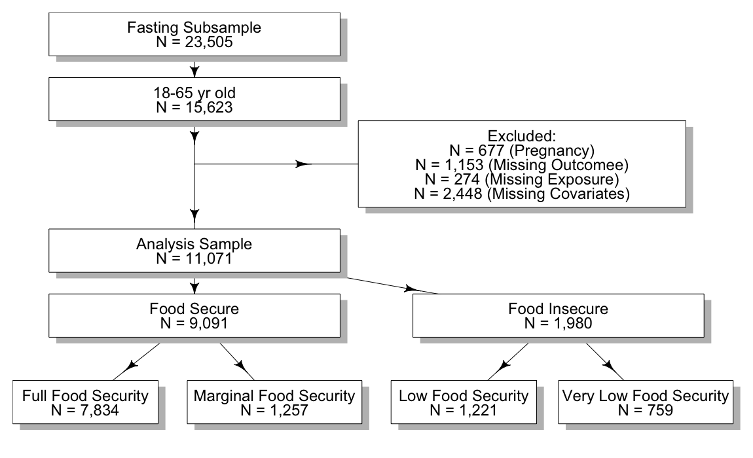

Slide 6
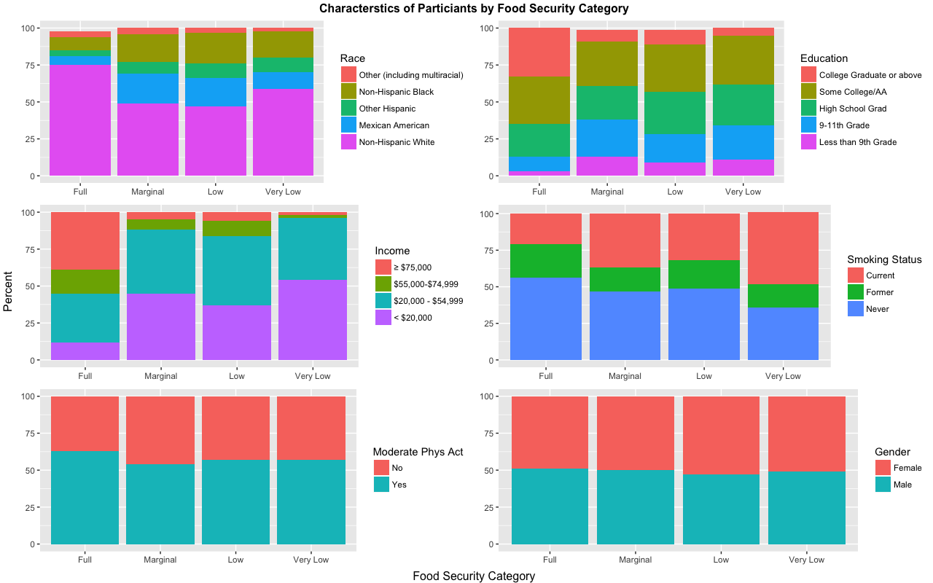
Characteristics of Study Participants by Food Security Category
Notes:
Fully food secure individuals were significantly more likely to be NHW, have higher education, and higher incomes. They were moderately more likely to be never smokers and slightly more likely to report moderate physical activity and be male.

Slide 7
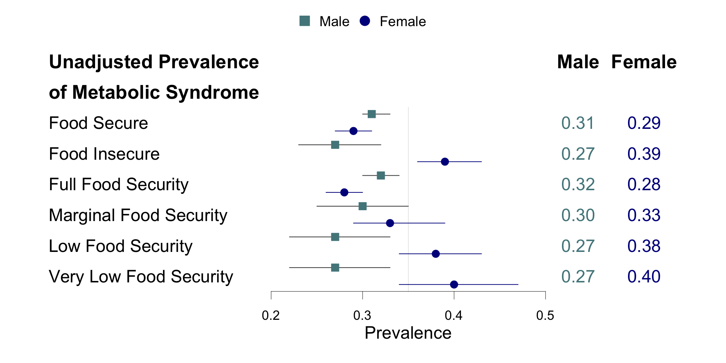
Results
Notes:
The unadjusted prevalence of metabolic syndrome was higher in males than females and tended to be higher in the higher food insecurity categories in females. Metabolic syndrome tended to decrease in higher food security categories in males. Food insecurity was significantly associated with metabolic syndrome in females when compared to food secure females. Low food security was also significantly associated with metabolic syndrome in females compared to full food security.

Slide 8
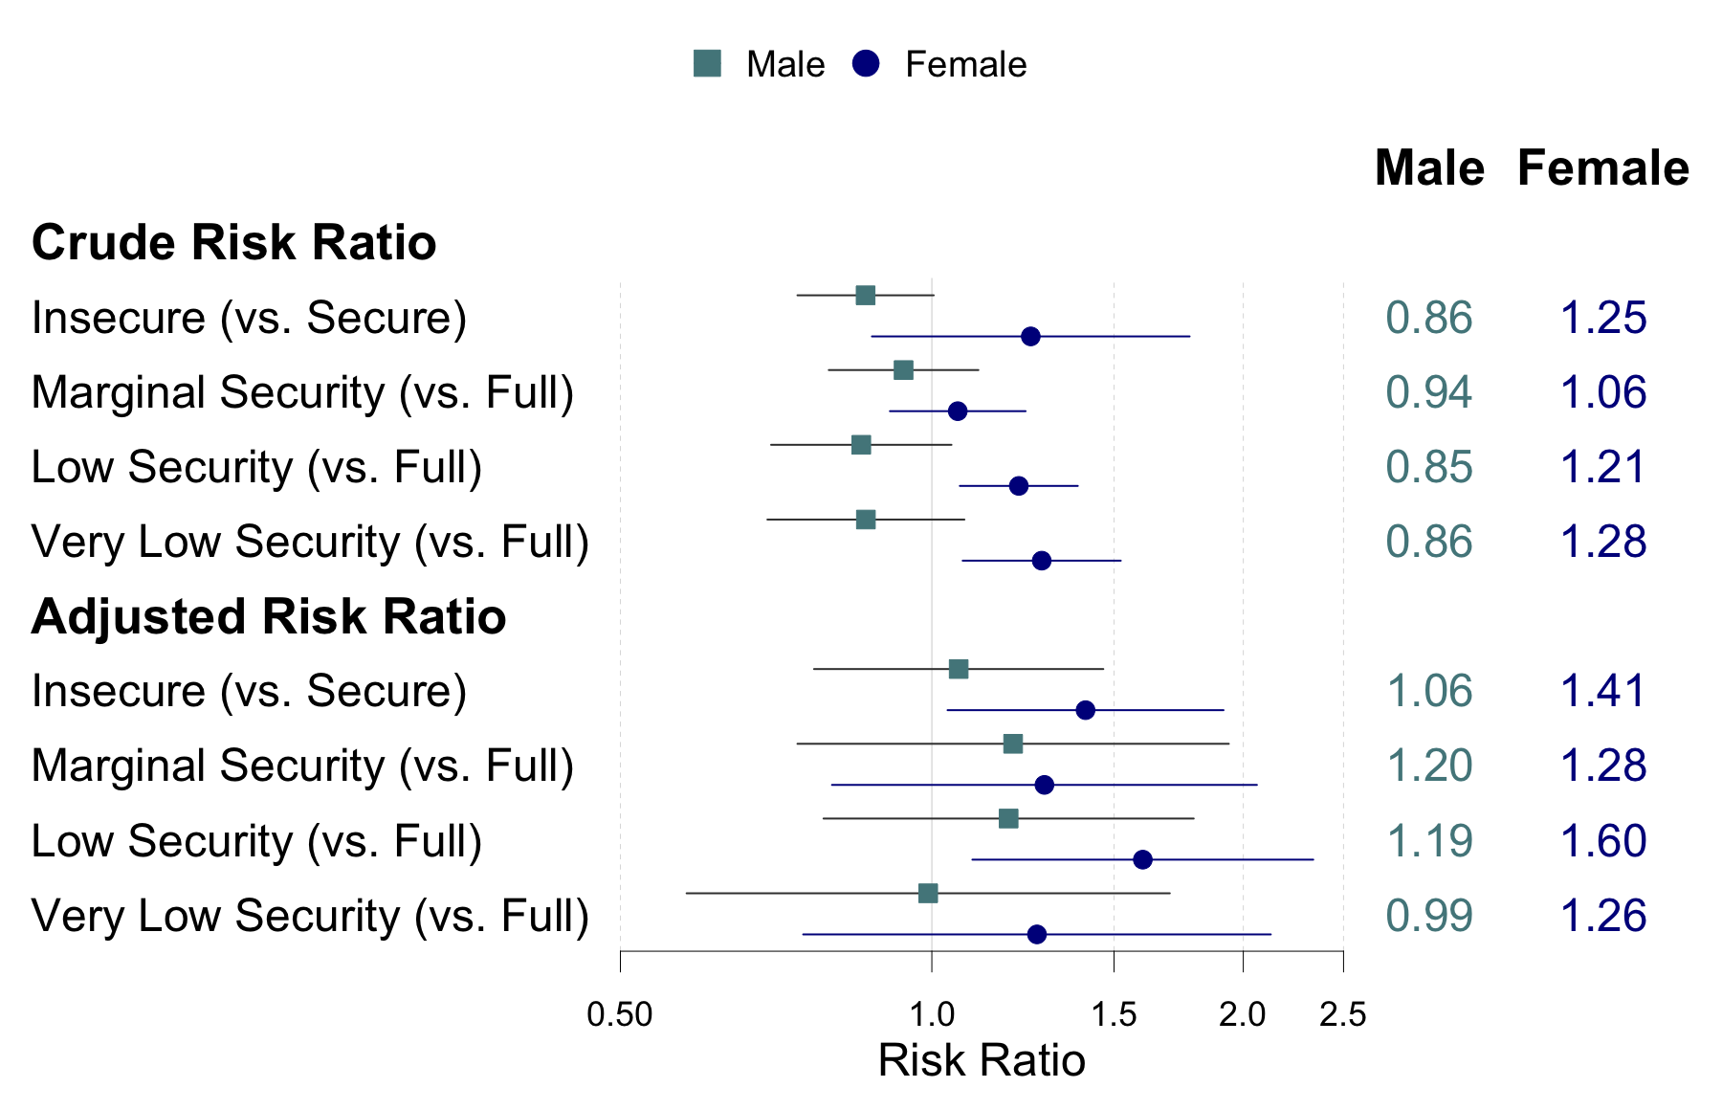
Results
Notes:
. Food insecurity was significantly associated with metabolic syndrome in females when compared to food secure females. Low food security was also significantly associated with metabolic syndrome in females compared to full food security.

Slide 9
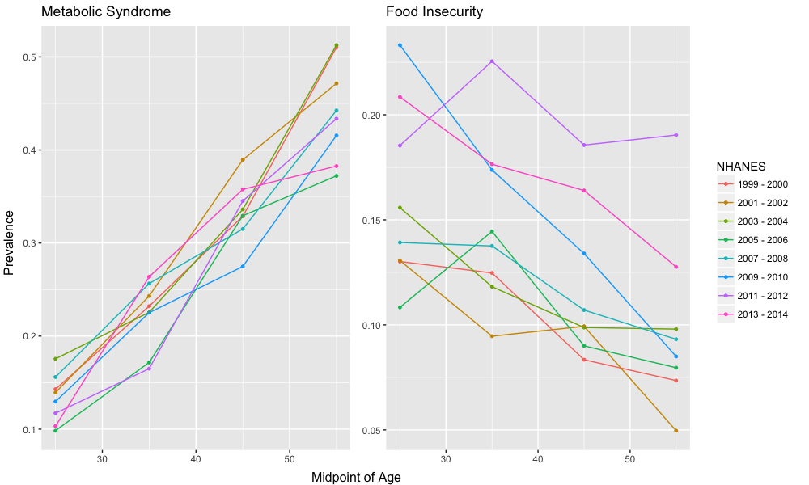
Outcome and Exposure by Age and NHANES Cycle
Notes:
The prevalence of metabolic syndrome increases with age but has remained fairly constant over time. The prevalence of food insecurity decreases with age and has been higher in recent years. Recent results of the USDA surveys indicate this trend maybe reversing. This up tick may have been caused by reporting changes, or the economic recession in 2009. We adjusted for NHANES cycle in our analysis.

Slide 10
Discussion
Previous studies have also found gender differences in associations between food insecurity and health outcomes.
Further strengthens evidence of association between poor cardiovascular and metabolic health and food insecurity in females
Notes:
Previous research has identified gender differences in the association between food insecurity and similar outcomes such as BMI, type 2 diabetes, insulin resistance and diet quality. Further research to explore the causes of these gender differences is warranted. Men and women may be willing to report food security differently or they may respond to food scarcity differently either from a social standpoint or a physiological one.
The finding of a significant association between food insecurity and metabolic syndrome further strengthens evidence of association between poor cardiovascular and metabolic health and food insecurity in females. These finding suggests that addressing food insecurity may be an effective means of preventing clinical disease in females if interventions occur early.

Slide 11
Strengths & Limitations
Large sample size representative of US population
Multiple cycles allows us to examine the relationship over many years
Cross-sectional design
Food Security was self reported
Metabolic Syndrome was classified based on a single measurement in time
Notes:
By combing multiple cycles of data, we are able to achieve a large sample size. In addition, NHANES is designed to be representative of the US population allowing us to make broader inferences. By examining multiple cycles over almost 2 decades we can explore the relationship between metabolic syndrome and food security over time. Because we believe the relationship with food insecurity and metabolic syndrome is cumulative, we are limited by the cross sectional nature of the study, we are unable to examine the relationship in individuals who may have been chronically food insecure previously but who are no longer, nor are we able to analyze metabolic syndrome later on in individuals that are food insecure now. Food security was self reported and there may be differences in reporting among different populations. In addition, metabolic syndrome was classified based on single measurements in time that may have been inaccurate or randomly high or low.

Slide 12
Public Health Implications
Males and Females may respond to resource scarcity differently
Attempts to address cardiovascular disease and type II diabetes with exercise and diet alone may not be effective in females.
Notes:
Males and Females may respond to resource scarcity differently, further research is needed to determine the causes of these differences. Attempts to address cardiovascular disease and type II diabetes with exercise and diet alone may not be effective in females. However, our findings suggest that addressing food insecurity issues may bean effective way to prevent metabolic syndrome in females.

Slide 13
Conclusions
There are significant gender differences in the association between food insecurity and metabolic syndrome.
Food insecure females have a 41% (95% CI: 4% - 91%) higher risk of metabolic syndrome than food secure females

Slide 14
Acknowledgments
Anna Barón, PhD Dept of Biostatistics, Colorado School of Public Health
Dana Dabelea, PhD Dept of Epidemiology, Colorado School of Public Health

